Slide 1
Improved Truthful Mechanisms for Subadditive Combinatorial Auctions: Breaking the Logarithmic Barrier
Authors: Sepehr Assadi, Thomas Kesselheim, Sahil Singla
Presenter: Theodor Tsilivis

Slide 2


Combinatorial Auctions – The problem
N bidders:
M items:

Slide 3
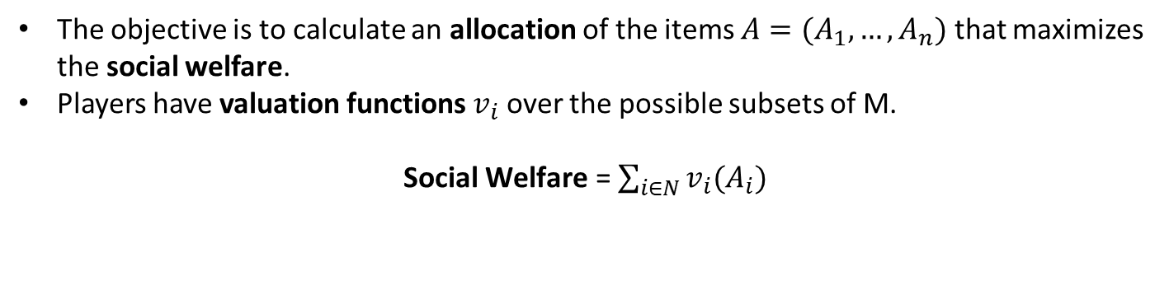
The objective
The objective is to calculate an allocation of the items $A=(A_{1}, …,A_{n})$ that maximizes the social welfare.
Players have valuation functions $v_{i}$ over the possible subsets of M.
Social $\text{Welfare}\text{ =}$ $\sum_{i∈N}{v_{i}(A_{i})}$
N bidders:
M items:
In this case the allocation is $A=(\{1,2\},∅,\{3,4\},∅,\{5\})$

Slide 4
Valuations – Bidder 1
N bidders:
M items:
v {1} = 2 v {2} = 3 v {3} = 5 v {4} = 2 v {5} = 2

Slide 5
Valuations – Bidder 1
N bidders:
M items:
v {1} = 2 v {2} = 3 v {3} = 5 v {4} = 2 v {5} = 2
v {1,2} = 5

Slide 6
Valuations – Bidder 1
N bidders:
M items:
v {1} = 2 v {2} = 3 v {3} = 5 v {4} = 2 v {5} = 2
v {1,2} = 5
v {2,3} = 8

Slide 7
Valuations – Bidder 1
N bidders:
M items:
v {1} = 2 v {2} = 3 v {3} = 5 v {4} = 2 v {5} = 2
v {1,2} = 5
v {2,3} = 8
v {3,4} = 6

Slide 8
Valuations – Bidder 1
N bidders:
M items:
v {1} = 2 v {2} = 3 v {3} = 5 v {4} = 2 v {5} = 2
v {1,2} = 5
v {2,3} = 8
v {3,4} = 6
v {4,5} = 3

Slide 9
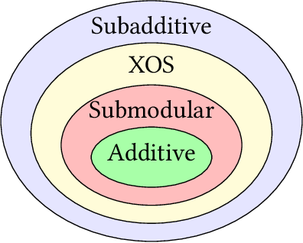

Valuation function classes
Additive: $v\left(S\right)+v\left(T\right)=v\left(S∪T\right)+v\left(S∩T\right) ∀\left(S,T\right)$
Submodular: $v\left(S\right)+v\left(T\right)≥v\left(S∪T\right)+v(S∩T) ∀\left(S,T\right)$
Subadditive: $v\left(S\right)+v\left(T\right)≥v\left(S∪T\right) ∀\left(S,T\right)$

Slide 10
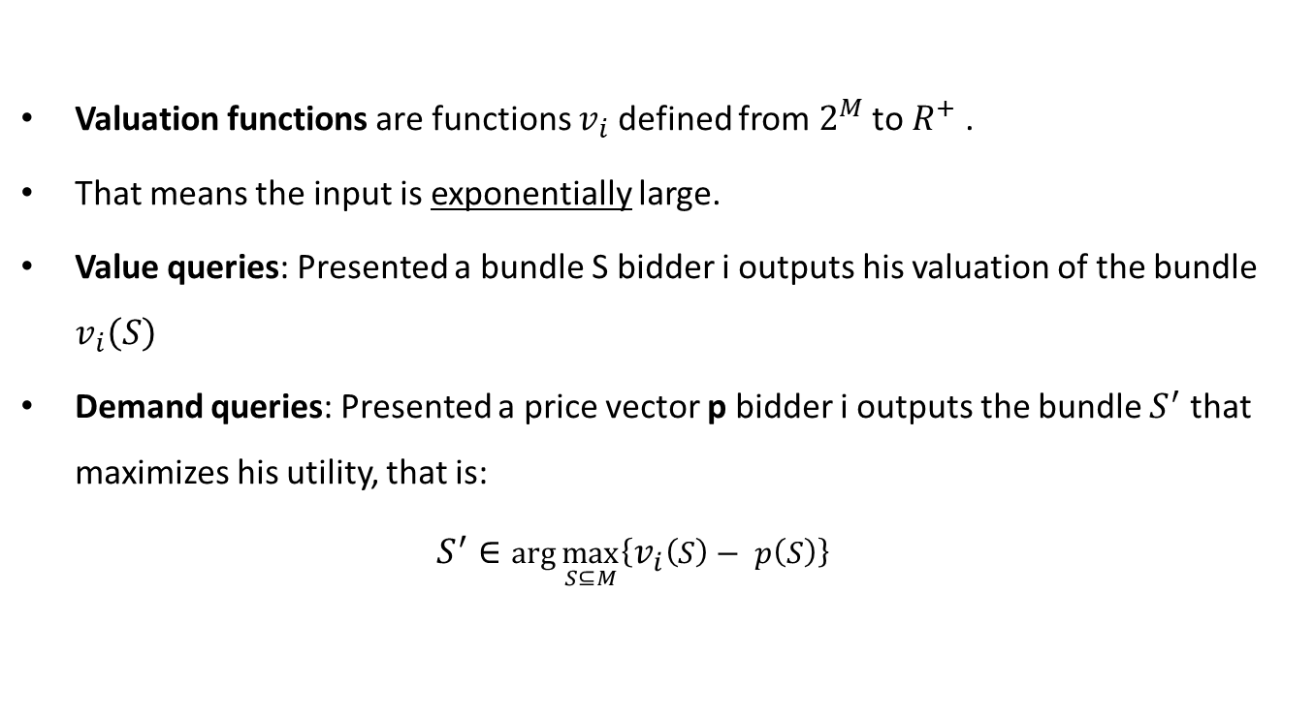
Accessing valuation functions
Valuation functions are functions $v_{i}$ defined from $2^{M}$ to $R^{+}$ .
That means the input is exponentially large.
Value queries: Presented a bundle S bidder i outputs his valuation of the bundle $v_{i}\left(S\right)$
Demand queries: Presented a price vector p bidder i outputs the bundle $S^{′}$ that maximizes his utility, that is: $S^{′}∈\arg{\max_{S⊆M}\left\{v_{i}\left(S\right)− p\left(S\right)\right\}}$

Slide 11

Value queries:
$v_{i}\left(\left\{1,2,3\right\}\right)$ = 12
Demand queries:
With these prices I want S = {2,3}
p {1} = 9 p {2} = 3 p {3} = 5

Slide 12
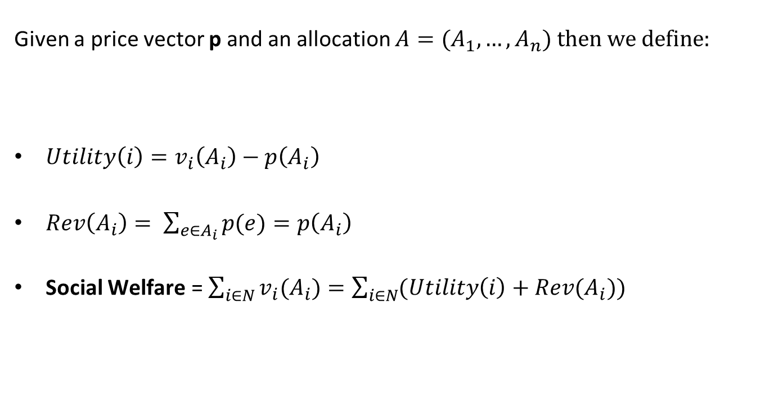
Utility – Revenue and Social Welfare
Given a price vector p and an allocation $A=(A_{1}, …,A_{n})$ then we define:
${Utility\left(i\right)=v}_{i}\left(A_{i}\right)−p\left(A_{i}\right)$
$Rev\left(A_{i}\right)= \sum_{e∈A_{i}}{p(e)}=p\left(A_{i}\right)$
Social $\text{Welfare}\text{ =}$ $\sum_{i∈N}{v_{i}(A_{i})}=\sum_{i∈N}{(Utility\left(i\right)+Rev(A_{i}))}$

Slide 13
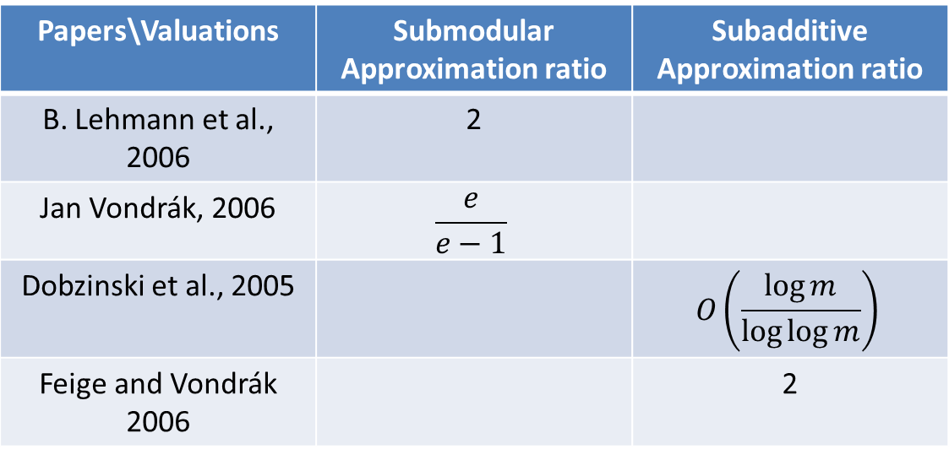
Algorithmic Viewpoint
Can we optimally solve the problem knowing that bidders do not misreport?
The problem is NP-hard (set packing).
There are constant approximation algorithms for the algorithmic problem for many valuation function classes.
Papers\Valuations | Submodular Approximation ratio | Subadditive Approximation ratio
B. Lehmann et al., 2006 | 2
Jan Vondrák, 2006 | $$\frac{e}{e−1}$$
Dobzinski et al., 2005 |  | $$O\left(\frac{\log{m}}{\log{\log{m}}}\right)$$
Feige and Vondrák 2006 |  | 2

Slide 14


Game theory - Truthfulness
Truthfulness is the property that for every bidder $i∈N$ revealing their true valuation in response to certain queries is a dominant strategy.
The previous algorithms do not capture truthfulness.
Papers\Valuations | Submodular Approximation ratio | Subadditive Approximation ratio
Dobzinski et al., 2006 | $$O\left(\log^{2}m\right)$$
P. Krysta and B. Vöcking, 2012 | $$O(\log{m})$$
Dobzinski, 2016 | $$O\left(\sqrt{\log{m}}\right)$$
S. Assadi, S. Singla, 2019 | $O\left({loglog}^{3}m\right)$
Dobzinski et al., 2005 |  | $$O\left(\sqrt{m}\right)$$
Dobzinski, 2007 |  | $$O\left(\log{m}\log{\log{m}}\right)$$
S. Assadi, T. Kesselheim, S. Singla, 2021 | $O\left({loglog}^{2}m\right)$ | $O\left({loglog}^{3}m\right)$
This paper

Slide 15
Price vectors – Learning procedures
Demand queries require a price vector p.
Truthfulness requires that no bidder can affect her utility by misreporting her valuation.
We need to learn from bidders better prices p but discourage bidders from taking advantage. How?
We design mechanisms that work the problem online.
Bidders come in once, answer their query, get allocated something (sometimes) and leave. This way we ensure learning and also truthfulness.
What can we do with good estimates of the prices?

Slide 16
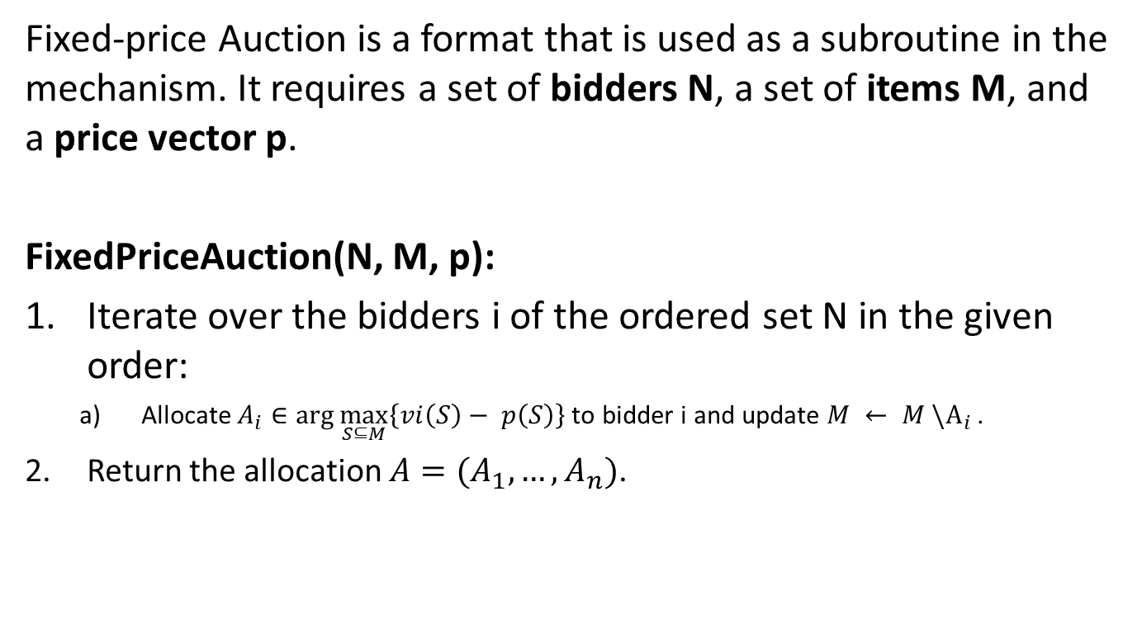
Fixed-Price Auction
Fixed-price Auction is a format that is used as a subroutine in the mechanism. It requires a set of bidders N, a set of items M, and a price vector p.
FixedPriceAuction(N, M, p):
Iterate over the bidders i of the ordered set N in the given order:
Allocate $A_{i}∈\arg{\max_{S⊆M}\left\{vi\left(S\right)− p\left(S\right)\right\}}$to bidder i and update $M ← M \backslash A_{i}$ .
Return the allocation $A=(A_{1}, …,A_{n})$.

Slide 17

Randomly place bidders into rounds
N bidders:
round 1 round 2 round 3
$$O\left(\log{\log{m}}\right)$$
Decide randomly that round 2 is the winning round.

Slide 18

Price vectors – Round 1
Suppose for every item the candidate price vector is ${b_{e}}^{(1)}=B=\left[0,1,2,4,8,16,32,64\right]$
Then price ${p_{e}}^{(\text{1})}=8$ for every item for round 1.
$$O\left(\log{m}\right)$$
M items:
${p_{1}}^{(\text{1})}=8 {p_{2}}^{(\text{1})}=8 {p_{3}}^{(\text{1})}=8 {p_{4}}^{(\text{1})}=8 {p_{5}}^{(\text{1})}=8$
Round 1:
Answers Demand query with {1,3}

Slide 19
Round 1 – FixedPrice Auction
Suppose for every item the candidate price vector is ${b_{e}}^{(1)}=B=\left[0,1,2,4,8,16,32,64\right]$
Then price ${p_{e}}^{(\text{1})}=8$ for every item for round 1.
$$O\left(\log{m}\right)$$
M items:
${p_{1}}^{(\text{1})}=8 {p_{2}}^{(\text{1})}=8 {p_{3}}^{(\text{1})}=8 {p_{4}}^{(\text{1})}=8 {p_{5}}^{(\text{1})}=8$
Round 1:
Answers Demand query with {2}

Slide 20

Round 1 – FixedPrice Auction
Suppose for every item the candidate price vector is ${b_{e}}^{(1)}=B=\left[0,1,2,4,8,16,32,64\right]$
Then price ${p_{e}}^{(\text{1})}=8$ for every item for round 1.
$$O\left(\log{m}\right)$$
M items:
${p_{1}}^{(\text{1})}=8 {p_{2}}^{(\text{1})}=8 {p_{3}}^{(\text{1})}=8 {p_{4}}^{(\text{1})}=8 {p_{5}}^{(\text{1})}=8$
Round 1:
Answers Demand query with {$∅$}

Slide 21





Round 1 finishes
Sold
$${b_{1}}^{(2)}=[0,1,2,4\text{,8,16,32,64] , }{p_{1}}^{(\text{2})}=32$$
Sold
$${b_{2}}^{(2)}=[0,1,2,4\text{,8,16,32,64], }{p_{2}}^{\left(\text{2}\right)}=32$$
Sold
$${b_{3}}^{(2)}=[0,1,2,4\text{,8,16,32,64], }{p_{3}}^{(\text{2})}=32$$
Not Sold
$${b_{4}}^{(2)}=[0,1,2,4,8,16,32\text{,64}]\text{, }{p_{4}}^{(\text{2})}=2$$
Not Sold
$${b_{5}}^{(2)}=[0,1,2,4,8,16,32\text{,64}]\text{, }{p_{5}}^{(\text{2})}=2$$

Slide 22
Round 2 begins (winning round)
${p_{1}}^{(\text{2})}=32 {p_{2}}^{(\text{2})}=32 {p_{3}}^{(\text{2})}=32 {p_{4}}^{(\text{2})}=2 {p_{5}}^{(\text{2})}=2$
Round 2:
Answers Demand query with {2,4,5}
No other players in this round. The auction completes since this is the winning round, and allocates items {2,4,5} to the red bidder.
Notice that green, orange and purple participated in the auction but got nothing and also that blue didn’t get a chance to participate.

Slide 23
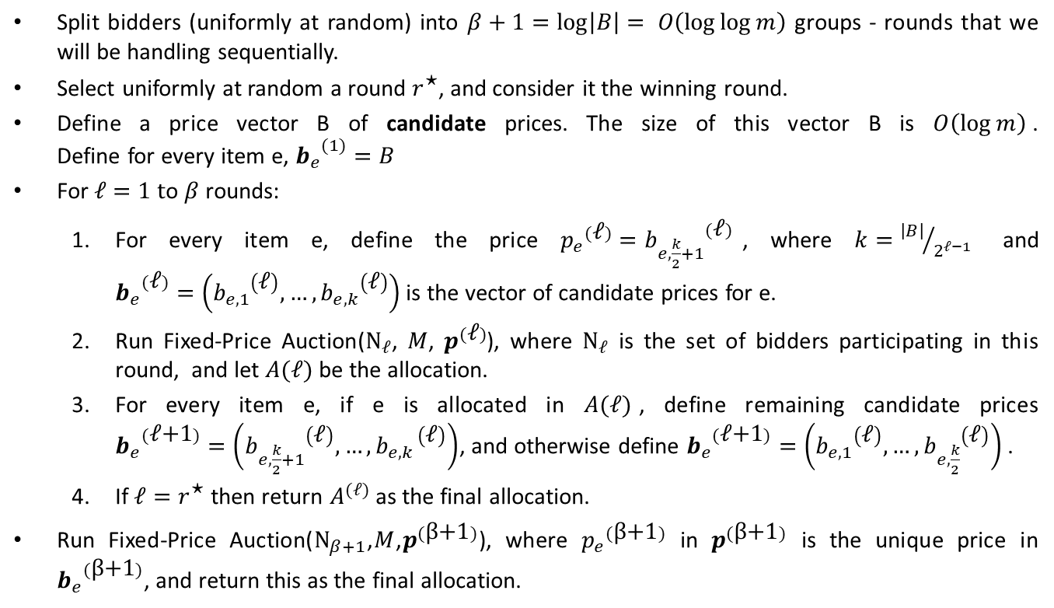
The Binary-Search Mechanism
Split bidders (uniformly at random) into $β+1=\log\left|B\right|= O\left(\log{\log{m}}\right)$ groups - rounds that we will be handling sequentially.
Select uniformly at random a round $r^{\text{⋆}}$, and consider it the winning round.
Define a price vector B of candidate prices. The size of this vector B is $O\left(\log{m}\right)$. Define for every item e, ${b_{e}}^{(1)}=B$
For $ℓ=1 t$o $β$ rounds:
For every item e, define the price ${p_{e}}^{(\text{ℓ})}={b_{e,\frac{k}{2}+1}}^{(\text{ℓ})}$, where $k={\left|B\right|}/{2^{ℓ−1}}$ and ${b_{e}}^{(\text{ℓ})}=\left({b_{e,1}}^{\left(\text{ℓ}\right)},…,{b_{e,k}}^{\left(\text{ℓ}\right)}\right)$ is the vector of candidate prices for e.
Run Fixed-Price Auction($Ν_{ℓ}$, $M$, $p^{(\text{ℓ})}$), where $Ν_{ℓ}$ is the set of bidders participating in this round, and let $A(ℓ)$ be the allocation.
For every item e, if e is allocated in $A(ℓ)$, define remaining candidate prices ${b_{e}}^{(\text{ℓ+1})}=\left({b_{e,\frac{k}{2}+1}}^{\left(\text{ℓ}\right)},…,{b_{e,k }}^{\left(\text{ℓ}\right)}\right)$, and otherwise define ${b_{e}}^{(\text{ℓ+1})}=\left({b_{e,1}}^{\left(\text{ℓ}\right)},…,{b_{e,\frac{k}{2}}}^{\left(\text{ℓ}\right)}\right)$ .
If $ℓ=r^{\text{⋆}}$ then return $A^{(ℓ)}$ as the final allocation.
Run Fixed-Price Auction($Ν_{β+1}$,$M$,$p^{(\text{β}\text{+1})}$), where ${p_{e}}_{}^{(\text{β}\text{+1})}$ in $p^{(\text{β}\text{+1})}$ is the unique price in ${b_{e}}^{(\text{β}\text{+1})}$, and return this as the final allocation.

Slide 24
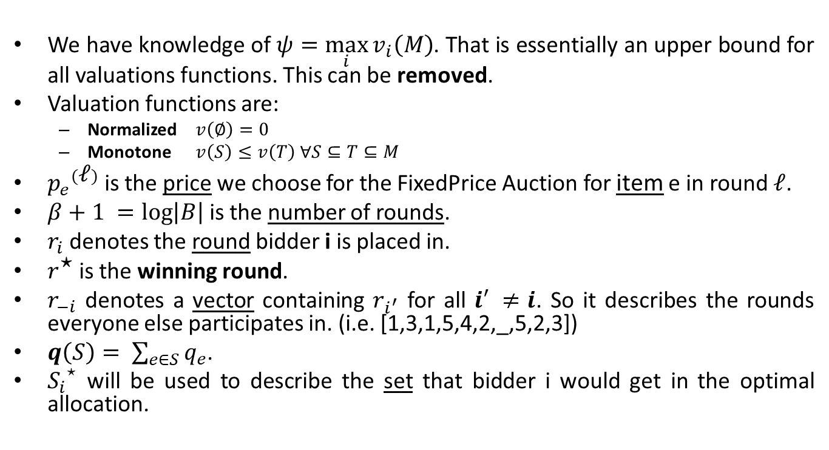
Standard assumptions and notation
We have knowledge of $ψ=\max_{i}{v_{i}\left(M\right)}$. That is essentially an upper bound for all valuations functions. This can be removed.
Valuation functions are:
Normalized $v\left(∅\right)=0$
Monotone $v\left(S\right)≤v\left(T\right) ∀S⊆T⊆M$
${p_{e}}^{(\text{ℓ})}$ is the price we choose for the FixedPrice Auction for item e in round $\text{ℓ}$.
$β+1 =\log\left|B\right|$ is the number of rounds.
$r_{i}$ denotes the round bidder i is placed in.
$r^{\text{⋆}}$ is the winning round.
$r_{−i}$ denotes a vector containing $r_{i^{′}}$ for all $i^{′} ≠i$. So it describes the rounds everyone else participates in. (i.e. [1,3,1,5,4,2,_,5,2,3])
$q\left(S\right)= \sum_{e∈S}{q_{e}}$.
${S_{i}}^{⋆}$ will be used to describe the set that bidder i would get in the optimal allocation.

Slide 25






Lemma 1([DKL20])
$ψ=\max_{i}v_{i}\left(M\right)$: Valuation Upper bound.
${p_{e}}^{(\text{ℓ})}$: item e price in round $\text{ℓ}$.
$β= log\left|B\right|$: number of rounds.
$r_{i}$: bidder i‘s round.
$r_{−i}$: everyone but i‘s round.
$r^{\text{⋆}}$: Winning round.
${S_{i}}^{⋆}$: Optimal allocation for i.
Lemma 1: Given any set of items $U⊆M$and valuation $v: 2^{M}→R^{+}$, there exists a distribution$λ$over item sets $S⊆U$ and prices $q^{⋆}∈R^{\left|U\right|}≥0$ such that for any set $T⊆U$, we have:
$\sum_{S⊆U}{λ_{S}}\left(v\left(S∖T\right)−q^{⋆}\left(S\right)\right)+ q^{⋆}\left(T\right) ≥ \frac{1}{a}·v(U)$.
Subadditive valuation $v$ then $α=O\left(\log{\log{m}}\right)$
XOS valuation $v$ then $α=O\left(1\right).$
Expected Utility
“Lost” Revenue
M
$$T$$
$$S\backslash T$$
$$E\left[Utility\left(S\backslash T\right)\right]+Rev\left(T\right)≥\frac{1}{a}v\left({S_{i}}^{⋆}\right)$$
That holds $∀S,T⊆{S_{i}}^{⋆}$ for some distribution $λ$and some price vector $q^{⋆}$
$${S_{i}}^{⋆}$$

Slide 26
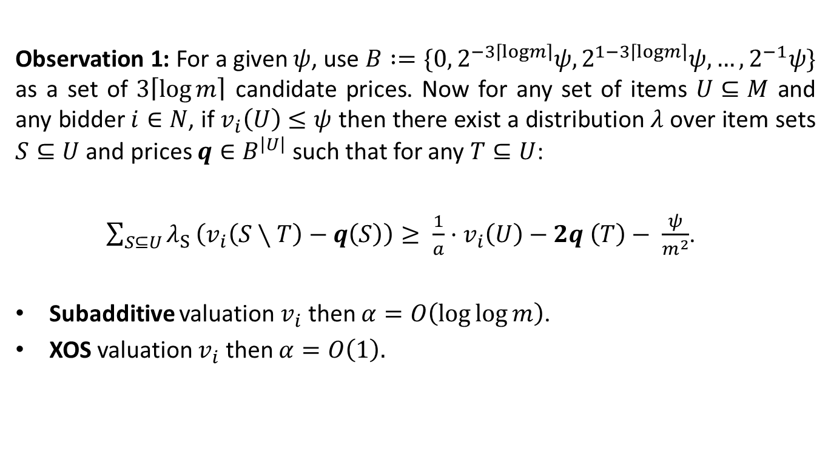
Binary search - Rounding prices
$ψ=\max_{i}v_{i}\left(M\right)$: Valuation Upper bound.
${p_{e}}^{(\text{ℓ})}$: item e price in round $\text{ℓ}$.
$β= log\left|B\right|$: number of rounds.
$r_{i}$: bidder i‘s round.
$r_{−i}$: everyone but i‘s round.
$r^{\text{⋆}}$: Winning round.
${S_{i}}^{⋆}$: Optimal allocation for i.
Observation 1: For a given $ψ$, use $B :=\{0, 2^{−3\left\lceil logm\right\rceil }ψ,2^{1−3\left\lceil logm\right\rceil }ψ, …,2^{−1}ψ\}$ as a set of $3\left\lceil \log{m}\right\rceil$ candidate prices. Now for any set of items $U⊆M$ and any bidder $i∈N$, if $v_{i}\left(U\right)≤ψ$ then there exist a distribution $λ$ over item sets $S⊆U$ and prices $q∈B^{\left|U\right|}$ such that for any $T⊆U$:
$\sum_{S⊆U}{λ_{S}}\left(v_{i}\left(S∖T\right)−q\left(S\right)\right)≥ \frac{1}{a}·v_{i}\left(U\right)−2q \left(T\right)− \frac{ψ}{m^{2}}$.
Subadditive valuation $v_{i}$ then $α=O\left(\log{\log{m}}\right)$.
XOS valuation $v_{i}$ then $α=O\left(1\right).$

Slide 27
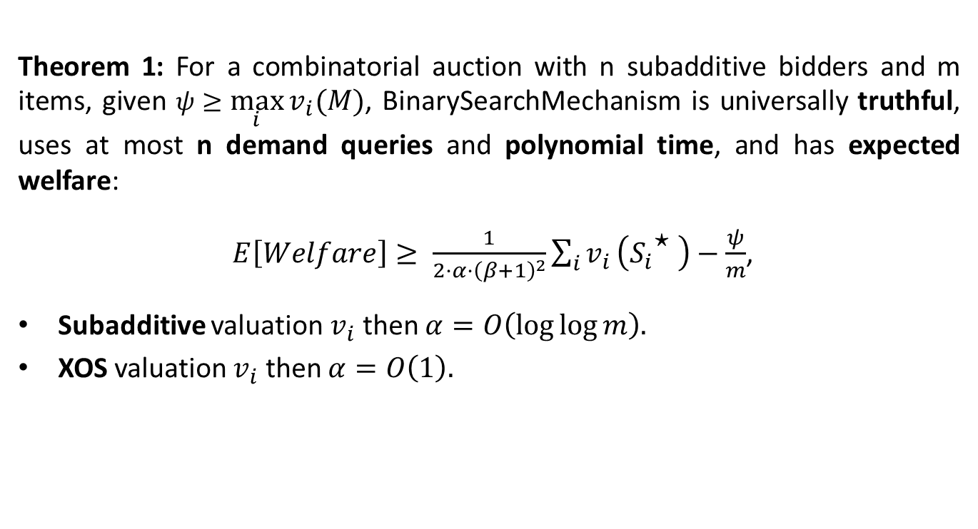
Theorem - Result
$ψ=\max_{i}v_{i}\left(M\right)$: Valuation Upper bound.
${p_{e}}^{(\text{ℓ})}$: item e price in round $\text{ℓ}$.
$β= log\left|B\right|$: number of rounds.
$r_{i}$: bidder i‘s round.
$r_{−i}$: everyone but i‘s round.
$r^{\text{⋆}}$: Winning round.
${S_{i}}^{⋆}$: Optimal allocation for i.
Theorem 1: For a combinatorial auction with n subadditive bidders and m items, given $ψ≥\max_{i}{v_{i}\left(M\right)}$, BinarySearchMechanism is universally truthful, uses at most n demand queries and polynomial time, and has expected welfare:
$E\left[Welfare\right]≥ \frac{1}{2·α·{\left(β+1\right)}^{2}}\sum_{i}{v_{i}}\left({S_{i}}^{\text{⋆}} \right)−\frac{ψ}{m}$,
Subadditive valuation $v_{i}$ then $α=O\left(\log{\log{m}}\right).$
XOS valuation $v_{i}$ then $α=O\left(1\right).$

Slide 28
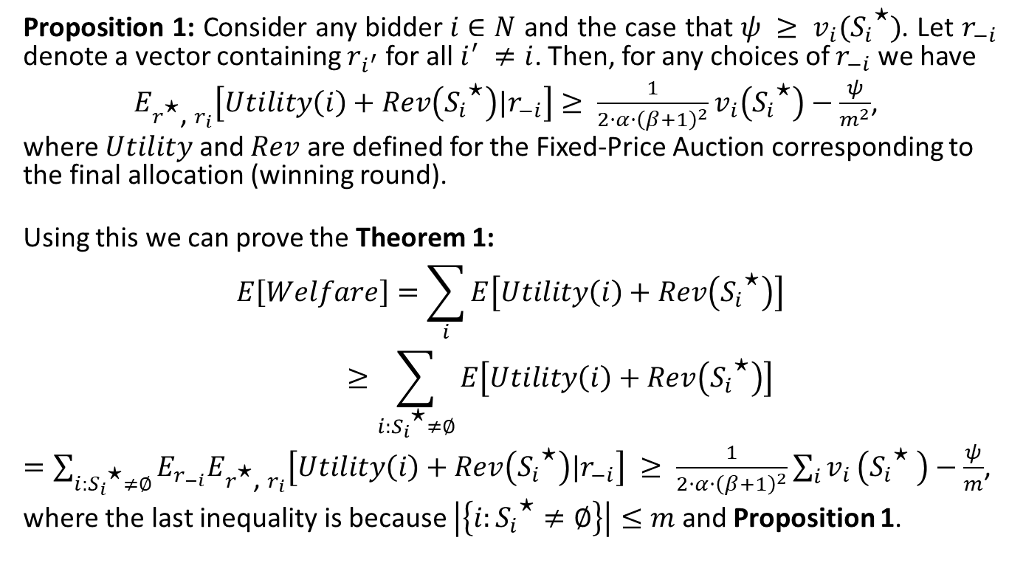
Proposition
$ψ=\max_{i}v_{i}\left(M\right)$: Valuation Upper bound.
${p_{e}}^{(\text{ℓ})}$: item e price in round $\text{ℓ}$.
$β= log\left|B\right|$: number of rounds.
$r_{i}$: bidder i‘s round.
$r_{−i}$: everyone but i‘s round.
$r^{\text{⋆}}$: Winning round.
${S_{i}}^{⋆}$: Optimal allocation for i.
Proposition 1: Consider any bidder $i∈N$ and the case that $ψ ≥ v_{i}({S_{i}}^{\text{⋆}})$. Let $r_{−i}$ denote a vector containing $r_{i^{′}}$ for all $i^{′} ≠i$. Then, for any choices of $r_{−i}$ we have
$E_{r^{\text{⋆}}\text{, }r_{i}}\left[Utility\left(i\right)+Rev\left({S_{i}}^{\text{⋆}}\right)|r_{−i}\right]≥ \frac{1}{2·α·{\left(β+1\right)}^{2}}v_{i}\left({S_{i}}^{\text{⋆}}\right)−\frac{ψ}{m^{2}}$,
where $Utility$ and $Rev$ are defined for the Fixed-Price Auction corresponding to the final allocation (winning round).
Using this we can prove the Theorem 1:
$$E\left[Welfare\right]=\sum_{i}{E\left[Utility\left(i\right)+Rev\left({S_{i}}^{\text{⋆}}\right)\right]}≥\sum_{i:{S_{i}}^{\text{⋆}}≠∅}{E\left[Utility\left(i\right)+Rev\left({S_{i}}^{\text{⋆}}\right)\right]}$$
$=\sum_{i:{S_{i}}^{\text{⋆}}≠∅}{E_{r_{−i}}E_{r^{\text{⋆}}\text{, }r_{i}}\left[Utility\left(i\right)+Rev\left({S_{i}}^{\text{⋆}}\right)|r_{−i}\right]} ≥ \frac{1}{2·α·{\left(β+1\right)}^{2}}\sum_{i}{v_{i}}\left({S_{i}}^{\text{⋆}} \right)−\frac{ψ}{m}$,
where the last inequality is because $\left|\left\{i:{S_{i}}^{\text{⋆}}≠∅\right\}\right|≤m$ and Proposition 1.

Slide 29
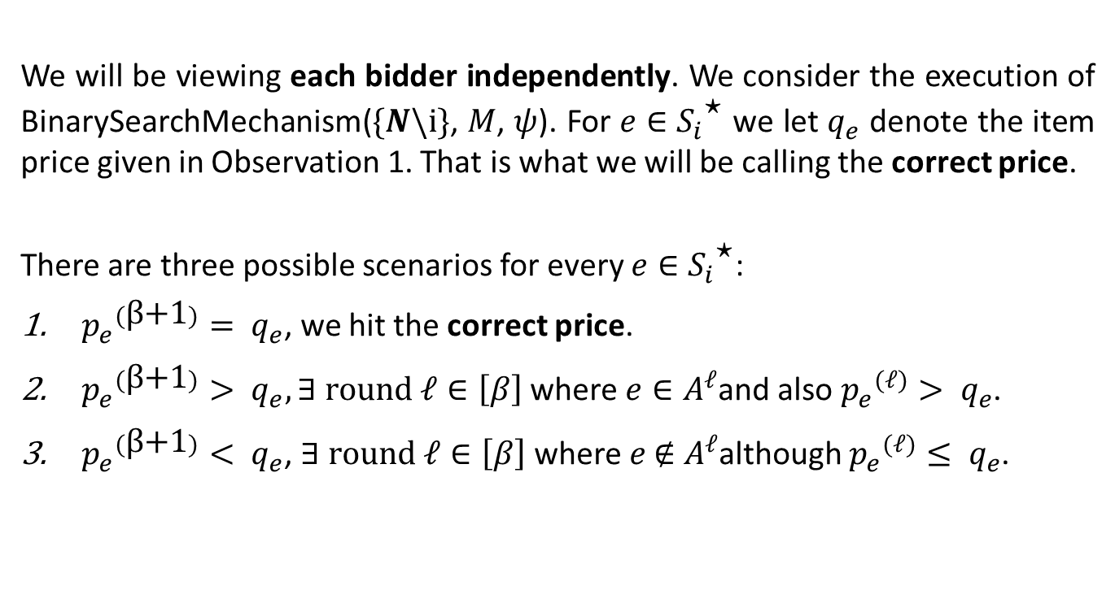
Proof of Proposition 1
$ψ=\max_{i}v_{i}\left(M\right)$: Valuation Upper bound.
${p_{e}}^{(\text{ℓ})}$: item e price in round $\text{ℓ}$.
$β= log\left|B\right|$: number of rounds.
$r_{i}$: bidder i‘s round.
$r_{−i}$: everyone but i‘s round.
$r^{\text{⋆}}$: Winning round.
${S_{i}}^{⋆}$: Optimal allocation for i.
We will be viewing each bidder independently. We consider the execution of BinarySearchMechanism($\{N\backslash i\}$, $M$, $ψ$). For $e∈{S_{i}}^{\text{⋆}}$ we let $q_{e}$ denote the item price given in Observation 1. That is what we will be calling the correct price.
There are three possible scenarios for every $e∈{S_{i}}^{\text{⋆}}$:
${p_{e}}_{}^{(\text{β}\text{+1})}= q_{e}$, we hit the correct price.
${p_{e}}_{}^{(\text{β}\text{+1})}> q_{e}, ∃ round ℓ∈\left[β\right]$ where $e∈A^{ℓ}$and also ${p_{e}}_{}^{(ℓ)}> q_{e}$.
${p_{e}}_{}^{(\text{β}\text{+1})}< q_{e}$, $∃ round ℓ∈\left[β\right]$ where $e \text{∉} A^{ℓ}$although ${p_{e}}_{}^{(ℓ)}≤ q_{e}$.

Slide 30
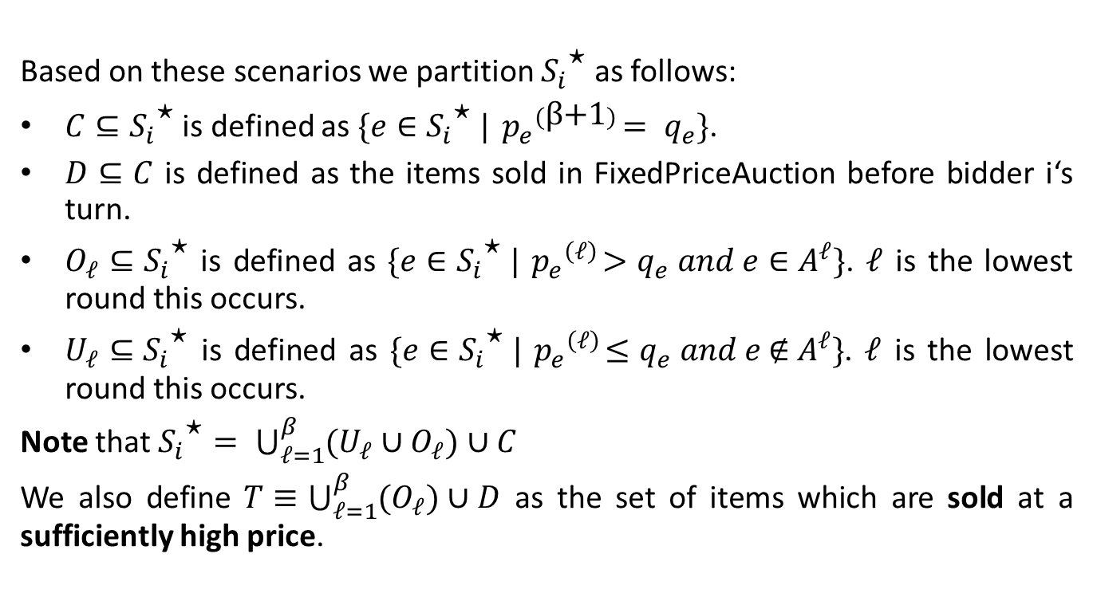
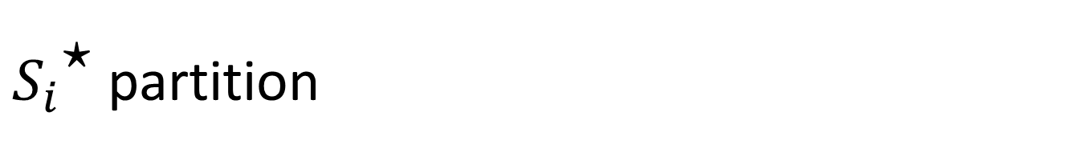
${S_{i}}^{\text{⋆}}$ partition
$ψ=\max_{i}v_{i}\left(M\right)$: Valuation Upper bound.
${p_{e}}^{(\text{ℓ})}$: item e price in round $\text{ℓ}$.
$β= log\left|B\right|$: number of rounds.
$r_{i}$: bidder i‘s round.
$r_{−i}$: everyone but i‘s round.
$r^{\text{⋆}}$: Winning round.
${S_{i}}^{⋆}$: Optimal allocation for i.
Based on these scenarios we partition ${S_{i}}^{\text{⋆}}$ as follows:
$C⊆{S_{i}}^{\text{⋆}}$ is defined as $\{e∈{S_{i}}^{\text{⋆}} |{ p_{e}}_{}^{(\text{β}\text{+1})}= q_{e}\}$.
$D⊆C$ is defined as the items sold in FixedPriceAuction before bidder i‘s turn.
$O_{ℓ}⊆{S_{i}}^{\text{⋆}}$ is defined as $\{e∈{S_{i}}^{\text{⋆}} |{ p_{e}}_{}^{\left(ℓ\right)}>q_{e} and e∈A^{ℓ}\}$. $ℓ$ is the lowest round this occurs.
$U_{ℓ}⊆{S_{i}}^{\text{⋆}}$ is defined as $\{e∈{S_{i}}^{\text{⋆}} |{ p_{e}}_{}^{\left(ℓ\right)}≤q_{e} and e \text{∉} A^{ℓ}\}$. $ℓ$ is the lowest round this occurs.
Note that ${S_{i}}^{\text{⋆}}= \bigcup_{ℓ=1}^{β}{(U_{ℓ}∪O_{ℓ})}∪C$
We also define $T≡\bigcup_{ℓ=1}^{β}{(O_{ℓ})}∪D$ as the set of items which are sold at a sufficiently high price.

Slide 31


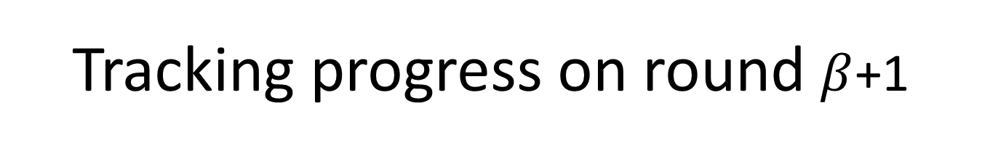
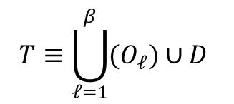



Tracking progress on round $β$+1
$$\left({S_{i}}^{\text{⋆}}\right)$$
${p_{1}}^{(β+1)}=8 {p_{2}}^{(β+1)}=4 {p_{3}}^{(β+1)}=16 {p_{4}}^{(β+1)}=4 {p_{5}}^{(β+1)}=64$
$${ q}_{1} =16 q_{2} =2 q_{3} =16 q_{4} =4 q_{5} =64$$
$$T≡\bigcup_{ℓ=1}^{β}{(O_{ℓ})}∪D$$
$$C⊆{S_{i}}^{\text{⋆}}$$
$$D⊆C$$
$$O_{ℓ}⊆{S_{i}}^{\text{⋆}}$$
$$U_{ℓ}⊆{S_{i}}^{\text{⋆}}$$

Slide 32











We will use $T$ to bound the $E\left[Rev\left({S_{i}}^{\text{⋆}}\right)\right]$ and $S\backslash T$ to bound the $E\left[Utility\left(i\right)\right].$
Note that the first expectation over the revenue of the items within ${S_{i}}^{\text{⋆}}$ (almost irrelevant who gets them) while the second expectation is over a specific bidder i.
M
$$O_{ℓ}$$
Bound Revenue in round $ℓ$
$$O_{ℓ}$$
$$U_{ℓ}∩S$$
$$D$$
Bound Revenue in round $β+1$
$$C\backslash D$$
Bound Utility in round $ℓ$
$${S_{i}}^{⋆}$$
Bound Utility in round $β+1$

Slide 33
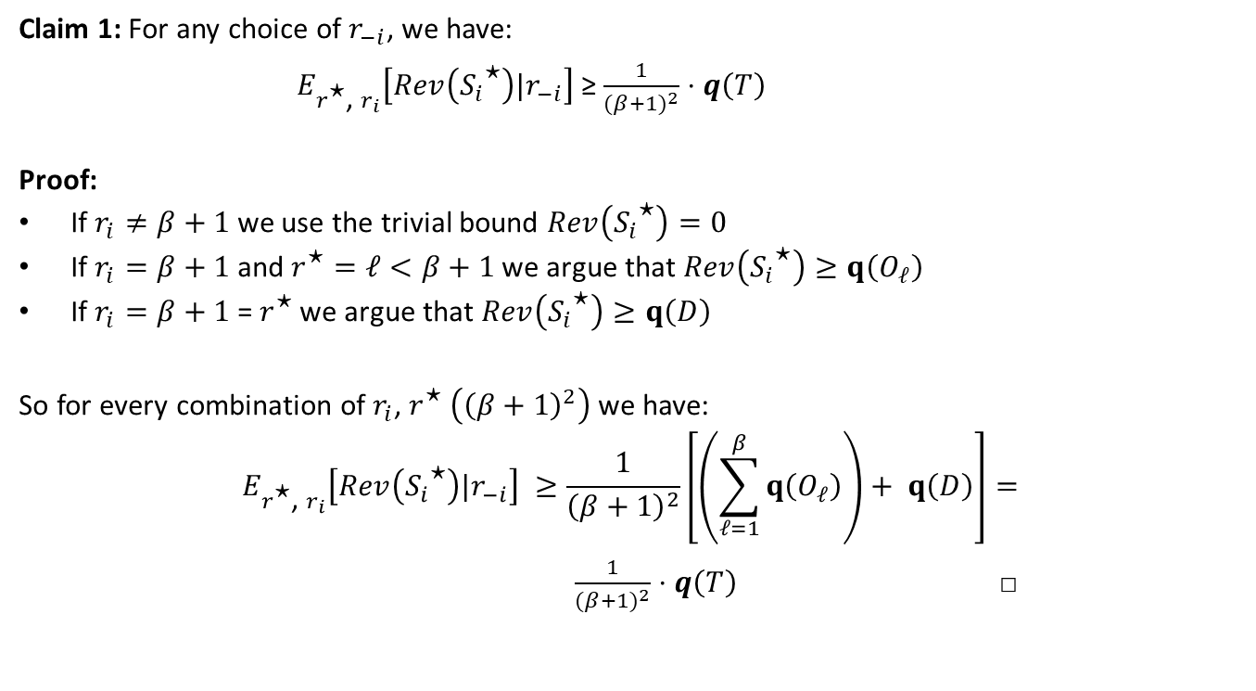
Revenue Bound
$ψ=\max_{i}v_{i}\left(M\right)$: Valuation Upper bound.
${p_{e}}^{(\text{ℓ})}$: item e price in round $\text{ℓ}$.
$β= log\left|B\right|$: number of rounds.
$r_{i}$: bidder i‘s round.
$r_{−i}$: everyone but i‘s round.
$r^{\text{⋆}}$: Winning round.
${S_{i}}^{⋆}$: Optimal allocation for i.
Claim 1: For any choice of $r_{−i}$, we have:
$E_{r^{\text{⋆}}\text{, }r_{i}}\left[Rev\left({S_{i}}^{\text{⋆}}\right)|r_{−i}\right]$≥ $\frac{1}{{(β+1)}^{2}}⋅q\left(T\right)$
Proof:
If $r_{i}≠β+1$ we use the trivial bound $Rev\left({S_{i}}^{\text{⋆}}\right)=0$
If $r_{i}=β+1$ and $r^{\text{⋆}}=ℓ<β+1$ we argue that $Rev\left({S_{i}}^{\text{⋆}}\right)≥q\left(O_{ℓ}\right)$
If $r_{i}=β+1$ = $r^{\text{⋆}}$ we argue that $Rev\left({S_{i}}^{\text{⋆}}\right)≥q\left(D\right)$
So for every combination of $r_{i}$, $r^{\text{⋆}} \left({\left(β+1\right)}^{2}\right)$ we have:
$$E_{r^{\text{⋆}}\text{, }r_{i}}\left[Rev\left({S_{i}}^{\text{⋆}}\right)|r_{−i}\right] ≥\frac{1}{{\left(β+1\right)}^{2}}\left[\left(\sum_{ℓ=1}^{β}{q\left(O_{ℓ}\right)}\right)+ q\left(D\right)\right]=$$ $\frac{1}{{(β+1)}^{2}}⋅q\left(T\right)$ □

Slide 34
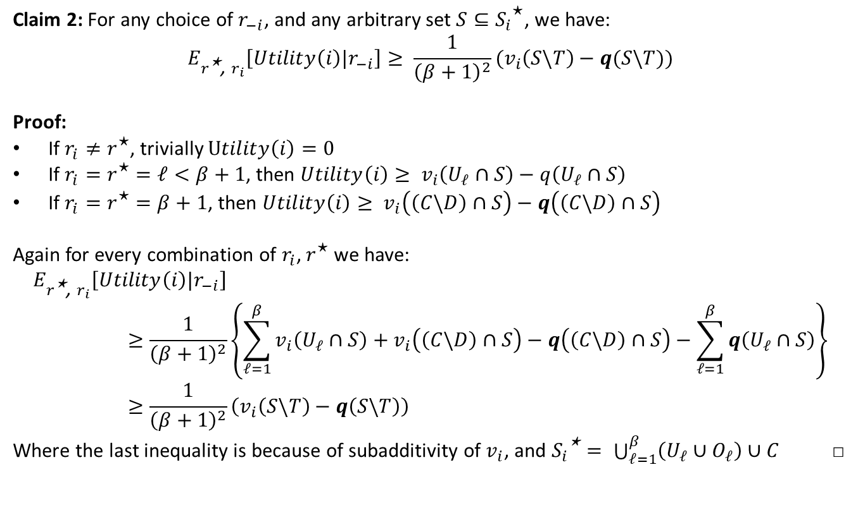
Utility Bound
$ψ=\max_{i}v_{i}\left(M\right)$: Valuation Upper bound.
${p_{e}}^{(\text{ℓ})}$: item e price in round $\text{ℓ}$.
$β= log\left|B\right|$: number of rounds.
$r_{i}$: bidder i‘s round.
$r_{−i}$: everyone but i‘s round.
$r^{\text{⋆}}$: Winning round.
${S_{i}}^{⋆}$: Optimal allocation for i.
Claim 2: For any choice of $r_{−i}$, and any arbitrary set $S⊆{S_{i}}^{\text{⋆}}$, we have:
$$E_{r^{\text{⋆}}\text{, }r_{i}}\left[Utility\left(i\right)|r_{−i}\right]≥ \frac{1}{{\left(β+1\right)}^{2}}{(v}_{i}\left(S\backslash T\right)−q(S\backslash T))$$
Proof:
If $r_{i}≠r^{\text{⋆}}$, trivially $Utility\left(i\right)=0$
If $r_{i}=r^{\text{⋆}}=ℓ<β+1$, then $Utility\left(i\right)≥ v_{i}\left(U_{ℓ}∩S\right)−q\left(U_{ℓ}∩S\right)$
If $r_{i}=r^{\text{⋆}}=β+1$, then $Utility\left(i\right)≥ v_{i}\left(\left(C\backslash D\right)∩S\right)−q\left(\left(C\backslash D\right)∩S\right)$
Again for every combination of $r_{i}$, $r^{\text{⋆}}$ we have:
$$E_{r^{\text{⋆}}\text{, }r_{i}}\left[Utility\left(i\right)|r_{−i}\right]≥\frac{1}{{\left(β+1\right)}^{2}}\left\{\sum_{ℓ=1}^{β}{v_{i}\left(U_{ℓ}∩S\right)}+v_{i}\left(\left(C\backslash D\right)∩S\right)−q\left(\left(C\backslash D\right)∩S\right)−\sum_{ℓ=1}^{β}{q\left(U_{ℓ}∩S\right)}\right\}≥\frac{1}{{\left(β+1\right)}^{2}}\left(v_{i}\left(S\backslash T\right)−q\left(S\backslash T\right)\right)$$
Where the last inequality is because of subadditivity of $v_{i}$, and ${S_{i}}^{\text{⋆}}= \bigcup_{ℓ=1}^{β}{\left(U_{ℓ}∪O_{ℓ}\right)}∪C$ □

Slide 35
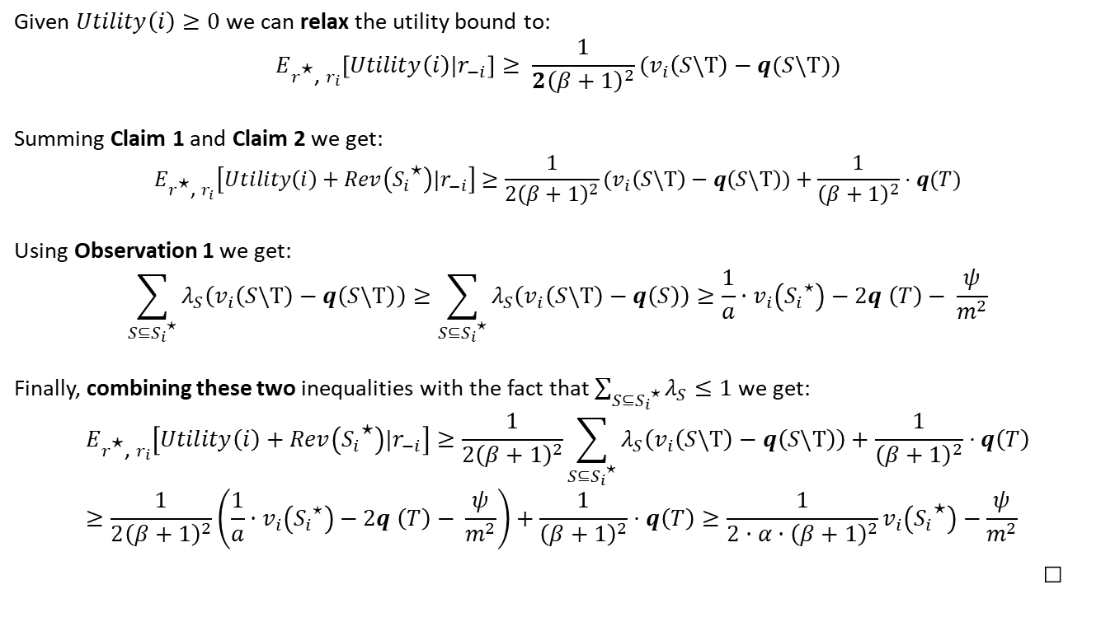
Finally bounding welfare
$ψ=\max_{i}v_{i}\left(M\right)$: Valuation Upper bound.
${p_{e}}^{(\text{ℓ})}$: item e price in round $\text{ℓ}$.
$β= log\left|B\right|$: number of rounds.
$r_{i}$: bidder i‘s round.
$r_{−i}$: everyone but i‘s round.
$r^{\text{⋆}}$: Winning round.
${S_{i}}^{⋆}$: Optimal allocation for i.
Given $Utility\left(i\right)≥0$ we can relax the utility bound to:
$$E_{r^{\text{⋆}}\text{, }r_{i}}\left[Utility\left(i\right)|r_{−i}\right]≥ \frac{1}{{2\left(β+1\right)}^{2}}{(v}_{i}\left(S\backslash T\right)−q(S\backslash T))$$
Summing Claim 1 and Claim 2 we get:
$$E_{r^{\text{⋆}}\text{, }r_{i}}\left[Utility\left(i\right)+Rev\left({S_{i}}^{\text{⋆}}\right)|r_{−i}\right]≥\frac{1}{{2\left(β+1\right)}^{2}}{(v}_{i}\left(S\backslash T\right)−q\left(S\backslash T\right))+\frac{1}{{\left(β+1\right)}^{2}}⋅q(T)$$
Using Observation 1 we get:
$$\sum_{S⊆{S_{i}}^{\text{⋆}}}{λ_{S}\left(v_{i}\left(S\backslash T\right)−q\left(S\backslash T\right)\right)}≥\sum_{S⊆{S_{i}}^{\text{⋆}}}{λ_{S}\left(v_{i}\left(S\backslash T\right)−q\left(S\right)\right)}≥\frac{1}{a}·v_{i}\left({S_{i}}^{\text{⋆}}\right)−2q \left(T\right)− \frac{ψ}{m^{2}}$$
Finally, combining these two inequalities with the fact that $\sum_{S⊆{S_{i}}^{\text{⋆}}}{λ_{S}≤1}$ we get:
$$E_{r^{\text{⋆}}\text{, }r_{i}}\left[Utility\left(i\right)+Rev\left({S_{i}}^{\text{⋆}}\right)|r_{−i}\right]≥\frac{1}{{2\left(β+1\right)}^{2}}\sum_{S⊆{S_{i}}^{\text{⋆}}}{λ_{S}\left(v_{i}\left(S\backslash T\right)−q\left(S\backslash T\right)\right)}+\frac{1}{{\left(β+1\right)}^{2}}⋅q\left(T\right) \\ ≥\frac{1}{{2\left(β+1\right)}^{2}}\left(\frac{1}{a}·v_{i}\left({S_{i}}^{\text{⋆}}\right)−2q \left(T\right)− \frac{ψ}{m^{2}}\right)+\frac{1}{{\left(β+1\right)}^{2}}⋅q\left(T\right)≥\frac{1}{2·α·{\left(β+1\right)}^{2}}v_{i}\left({S_{i}}^{\text{⋆}}\right)−\frac{ψ}{m^{2}}$$
□

Slide 36
Summing up
We discussed:
Valuation functions classes.
Access Queries.
Truthfulness.
The Binary-Search Mechanism.
Lemma of existence of prices and distribution.
Proof of Binary-Search Mechanism approximation.

Slide 37
Final Questions?

Slide 38
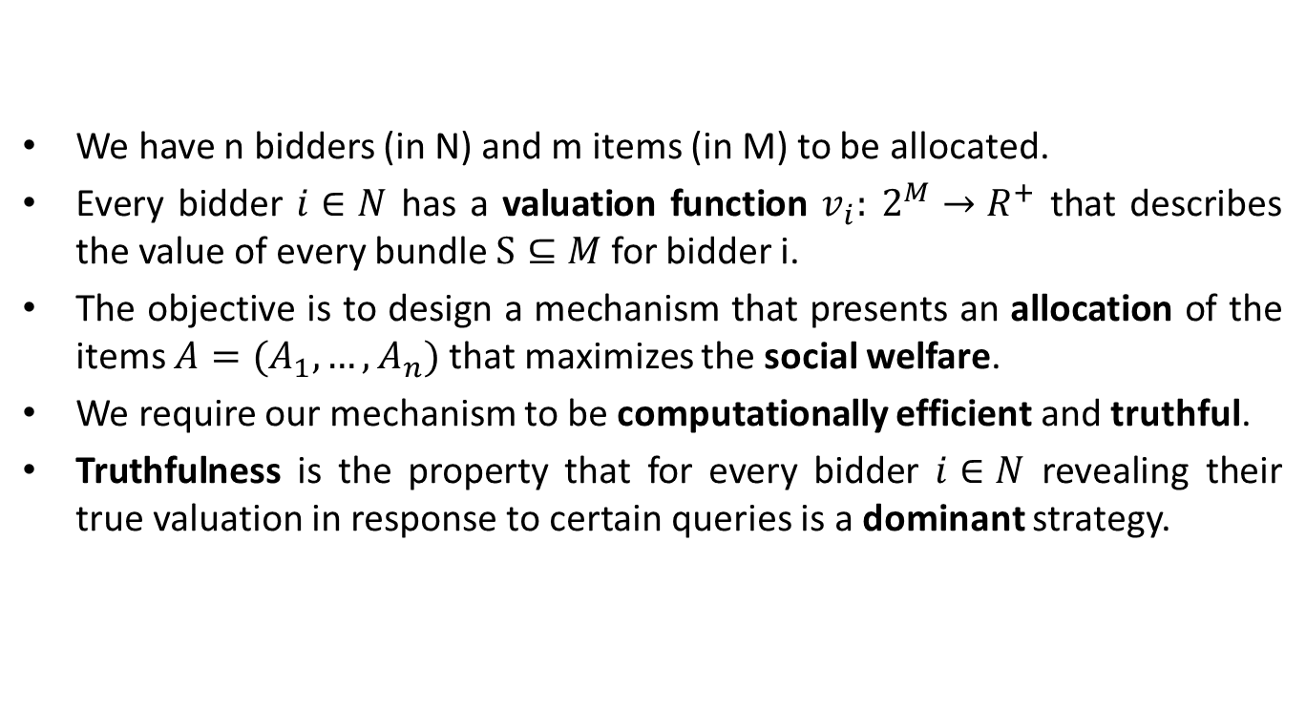
Combinatorial Auctions
We have n bidders (in N) and m items (in M) to be allocated.
Every bidder $i∈N$ has a valuation function $v_{i}: 2^{M}→R^{+}$ that describes the value of every bundle $S⊆M$ for bidder i.
The objective is to design a mechanism that presents an allocation of the items $A=(A_{1}, …,A_{n})$ that maximizes the social welfare.
We require our mechanism to be computationally efficient and truthful.
Truthfulness is the property that for every bidder $i∈N$ revealing their true valuation in response to certain queries is a dominant strategy.

Slide 39
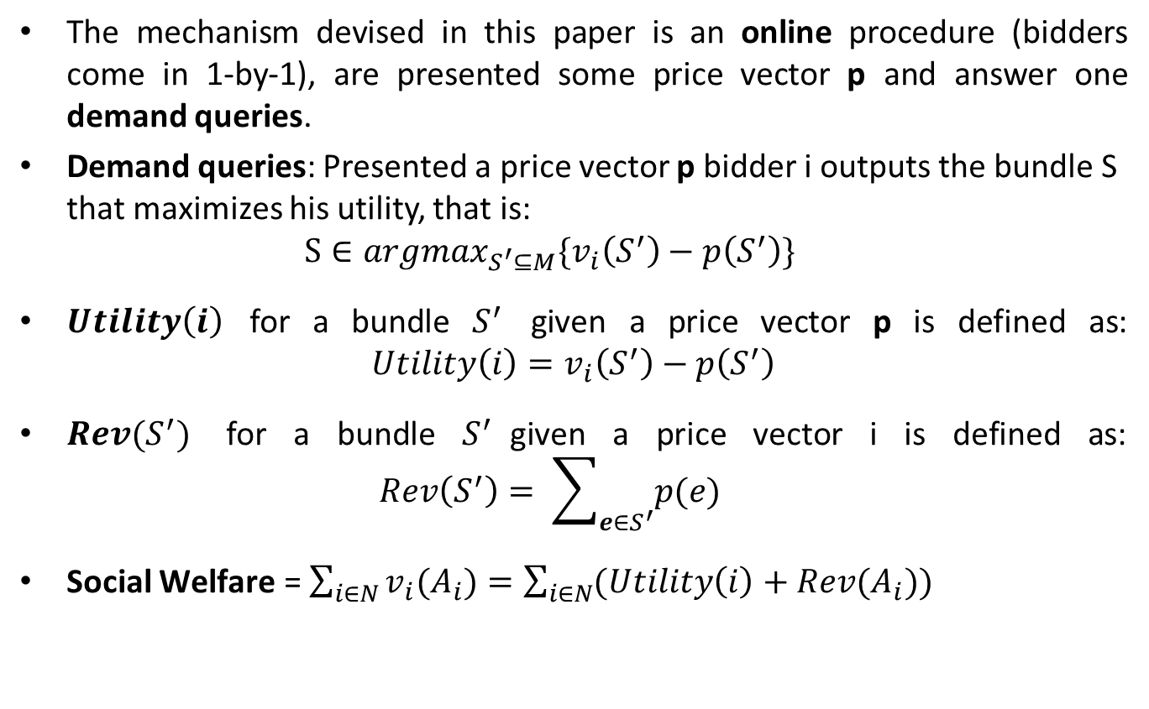
Definitions and notations
The mechanism devised in this paper is an online procedure (bidders come in 1-by-1), are presented some price vector p and answer one demand queries.
Demand queries: Presented a price vector p bidder i outputs the bundle S that maximizes his utility, that is: $S∈{argmax}_{S^{′}⊆M}\{v_{i}\left(S^{′}\right)−p\left(S^{′}\right)\}$
$Utility\left(i\right)$ for a bundle $S^{′}$ given a price vector p is defined as: ${Utility\left(i\right)=v}_{i}\left(S^{′}\right)−p\left(S^{′}\right)$
$Rev(S^{′})$ for a bundle $S^{′}$given a price vector i is defined as: $Rev\left(S^{′}\right)= \sum_{e∈S^{′}}{p(e)}$
Social $\text{Welfare} \text{=}$ $\sum_{i∈N}{v_{i}(A_{i})}=\sum_{i∈N}{(Utility\left(i\right)+Rev(A_{i}))}$

Slide 40
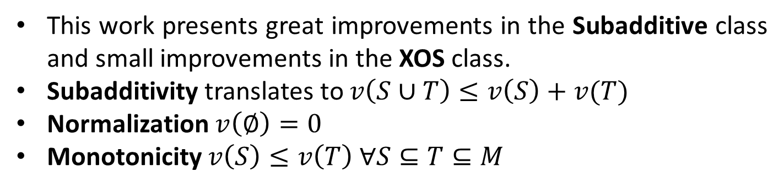
Classes of valuation functions and assumptions
This work presents great improvements in the Subadditive class and small improvements in the XOS class.
Subadditivity translates to $v\left(S∪T\right)≤v\left(S\right)+v(T)$
Normalization $v\left(∅\right)=0$
Monotonicity $v\left(S\right)≤v\left(T\right) ∀S⊆T⊆M$

Slide 41
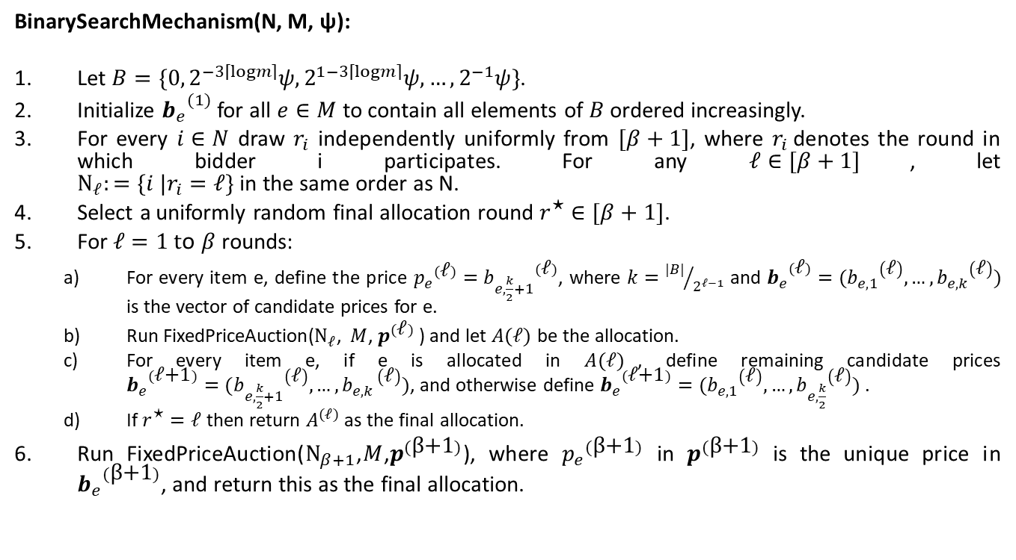
BinarySearchMechanism
BinarySearchMechanism(N, M, ψ):
Let $B=\{0, 2^{−3\left\lceil logm\right\rceil }ψ,2^{1−3\left\lceil logm\right\rceil }ψ, …,2^{−1}ψ\}$.
Initialize ${b_{e}}^{(1)}$ for all $e∈M$ to contain all elements of $B$ ordered increasingly.
For every $i∈N$ draw $r_{i}$ independently uniformly from $[β+1]$, where $r_{i}$denotes the round in which bidder i participates. For any $ℓ∈[β+1]$, let $Ν_{ℓ}:=\{i |r_{i}=ℓ\}$in the same order as N.
Select a uniformly random final allocation round $r^{\text{⋆}}∈[β+1]$.
For $ℓ=1 t$o $β$ rounds:
For every item e, define the price ${p_{e}}^{(\text{ℓ})}={b_{e,\frac{k}{2}+1}}^{(\text{ℓ})}$, where $k={|B|}/{2^{ℓ−1}}$ and ${b_{e}}^{(\text{ℓ})}=({b_{e,1}}^{\left(\text{ℓ}\right)},…,{b_{e,k}}^{\left(\text{ℓ}\right)})$ is the vector of candidate prices for e.
Run FixedPriceAuction($Ν_{ℓ}$, $M$, $p^{(\text{ℓ})}$ ) and let $A(ℓ)$ be the allocation.
For every item e, if e is allocated in $A(ℓ)$, define remaining candidate prices ${b_{e}}^{(\text{ℓ}\text{+1})}=({b_{e,\frac{k}{2}+1}}^{\left(\text{ℓ}\right)},…,{b_{e,k }}^{\left(\text{ℓ}\right)})$, and otherwise define ${b_{e}}^{(\text{ℓ}\text{+1})}=({b_{e,1}}^{\left(\text{ℓ}\right)},…,{b_{e,\frac{k}{2}}}^{\left(\text{ℓ}\right)})$ .
If $r^{\text{⋆}}=ℓ$ then return $A^{(ℓ)}$ as the final allocation.
Run FixedPriceAuction($Ν_{β+1}$,$M$,$p^{(\text{β}\text{+1})}$), where ${p_{e}}_{}^{(\text{β}\text{+1})}$ in $p^{(\text{β}\text{+1})}$ is the unique price in ${b_{e}}^{(\text{β}\text{+1})}$, and return this as the final allocation.

